Slide 1

Journey to My Goal From Vision to Reality – Becoming a Farm & Industrial Equipment Export Entrepreneur

Slide 2

What is My Goal?
Main Goal: To become an entrepreneur venturing in the buying and exporting of tractors and other farm and industrial equipment from the United Kingdom to Nigeria.
Expanded Explanation:
Nigeria has less import duty on agricultural and industrial machinery, making it a strategic market.
My business would focus on sourcing reliable equipment in the UK and exporting it to Nigerian dealers, farms, and industrial clients.
Responsibilities include: market research, supplier negotiations, export logistics, customs clearance, and after-sales services.

Slide 3

Strengths and Weaknesses
Strengths:
Strong negotiation skills earned during my business experience and economic studies.
Strong analytical and data skills to evaluate market and supplier trends.
Good communication and negotiation skills.
International exposure and cultural awareness.
Entrepreneurial mindset and commitment to long-term success.
Weaknesses:
Phobia of traveling. This leads to delegation of my role in business deals leading to poor sales due to low negotiated prices.
Limited initial capital.
Limited experience in international trade law.
Building a trustworthy logistics and distribution chain in Nigeria.

Slide 4

Environmental Analysis – Opportunities & Threats
Opportunities:
Growing demand for agricultural mechanisation in Nigeria.
Government incentives and lower duties for importing farm equipment.
Established networks in the UK and potential partnerships in Nigeria.
Untapped markets in rural regions.
Threats:
Political instability and policy changes in Nigeria.
High logistic costs and delays at Nigerian ports.
Currency fluctuation and trade barriers.
Competition from China and local suppliers.

Slide 5

Past Experience – Lessons Learned
Experiences:
Worked with international clients on data projects – taught me global business communication.
Participated in small-scale local reselling business – learnt about profit margins and customer satisfaction.
Faced setbacks with delayed shipments and learnt the value of reliable suppliers.
Lessons:
Always do due diligence.
Build a network of supportive mentors.
Learn from failure and adapt quickly.

Slide 6

Developing the Goal – Timeline & Actions
Area of Focus: Business Planning, Capital Raising, Logistics, Legal Compliance
Timeline:
2025 (Q3-Q4): Finalise business plan, identify suppliers and Nigerian partners.
2026 (Q1): Raise initial capital and begin pilot import.
2026 (Q2): Launch first shipment, evaluate process, adjust.
2027 (Q3-Q4): Expand operations, seek further investment.
Further Comments:
Will seek mentorship from successful exporters.
May consider partnering with local agricultural cooperatives in Nigeria.
Will gradually scale operations based on demand and capital.

Slide 7
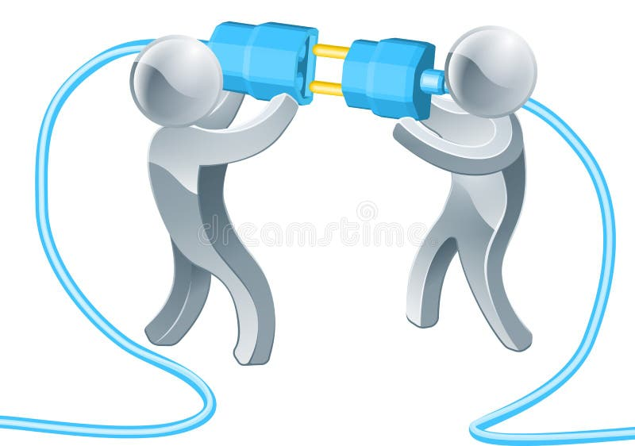
Conclusion
NOTE:
Agricultural and industrial machinery importation favoured by:
Less/no import duty
Incentives
Political instability, competition, limited capital and currency fluctuation are major hindrance.
International experience & local expertise, networking, and exporters’ mentorship drives the ambition.
Every successful journey begins with a single step. This is mine.

